Slide 1
Chapter 2 Basics of Cryptography
Symmetric Cipher Model
Substitution Techniques
Transportation Techniques
Other Cipher Properties- Confusion, Diffusion,
Block and Stream Ciphers.

Slide 2
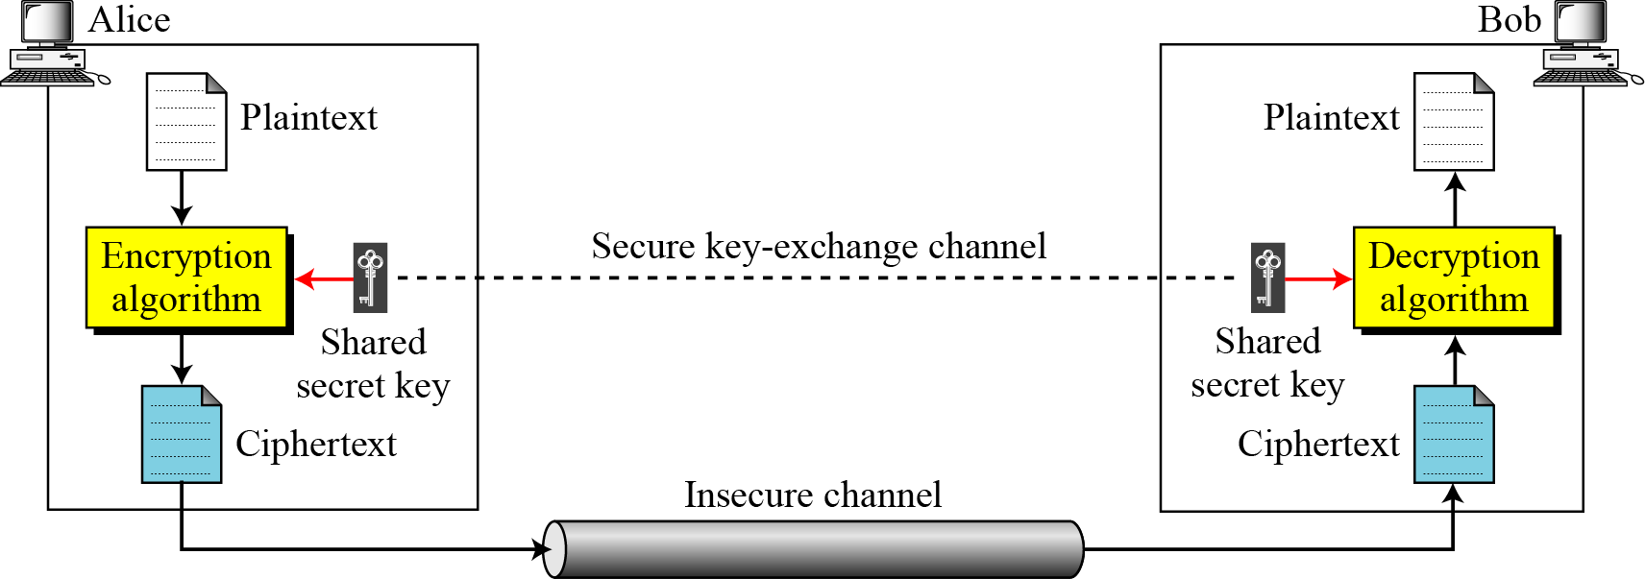
Symmetric cipher Model

Slide 3
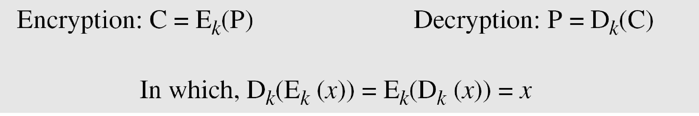
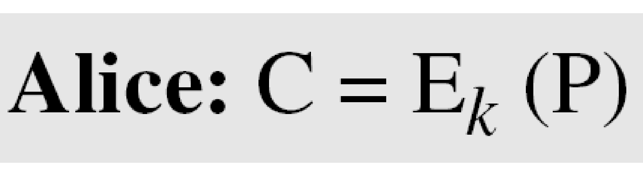
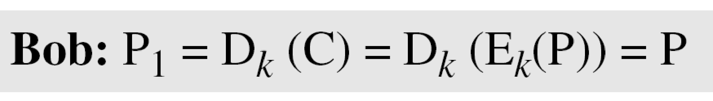
Symmetric cipher Model
If P is the plaintext, C is the ciphertext, and K is the key,
Symmetric cipher Model
We assume that Bob creates P₁; we prove that P₁ = P:

Slide 4
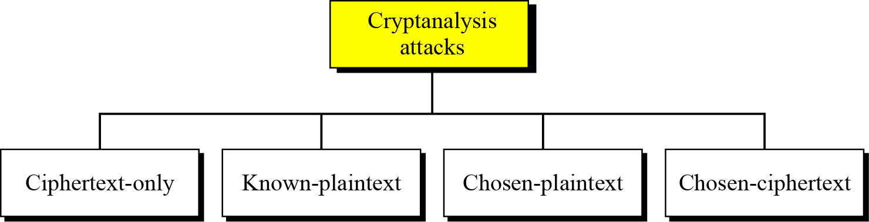
Cryptanalysis
Cryptography is the science and art of creating secret codes.
Cryptanalysis is the science and art of breaking those codes.

Slide 5
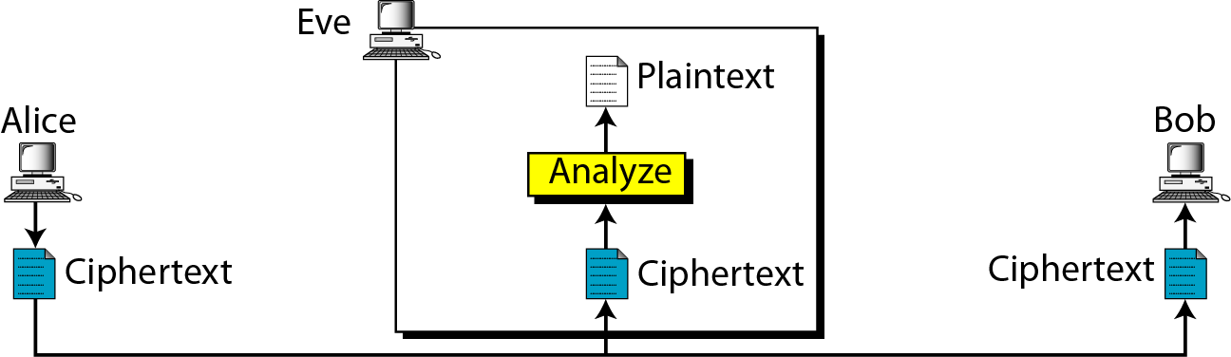
1. Ciphertext-Only Attack

Slide 6
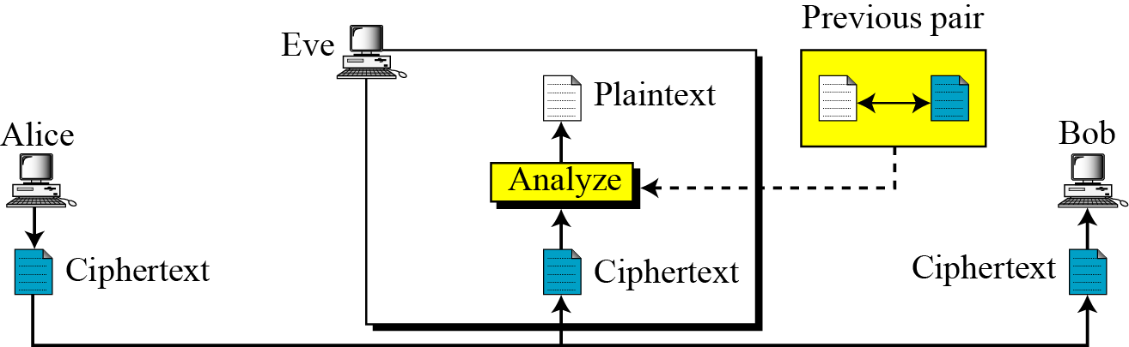
2. Known-Plaintext Attack
Attacker knows some previous plaintext/ciphertext.
On that basis try to analyze new intercepted ciphertext.

Slide 7
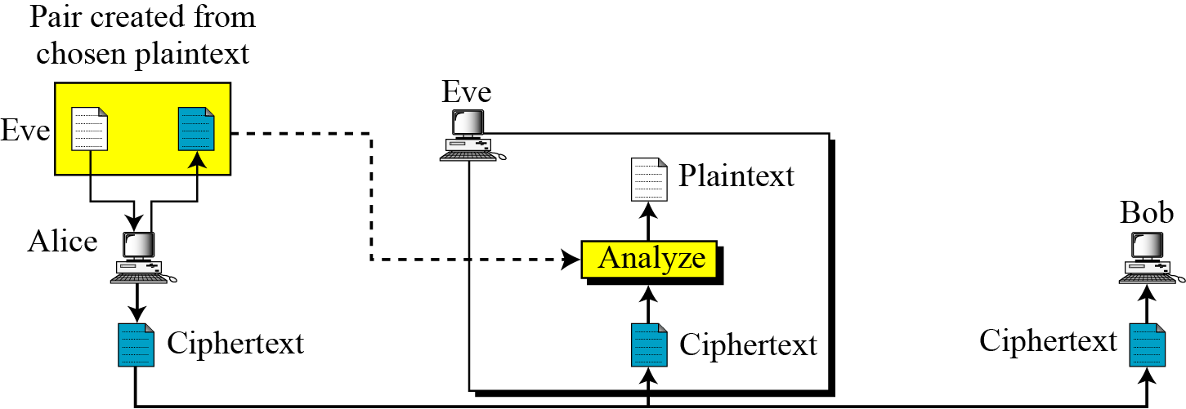
3. Chosen-Plaintext Attack
Attacker will attack to chose some plaintext of her own interest from sender’s machine.
On that basis try to analyze new intercepted ciphertext.

Slide 8
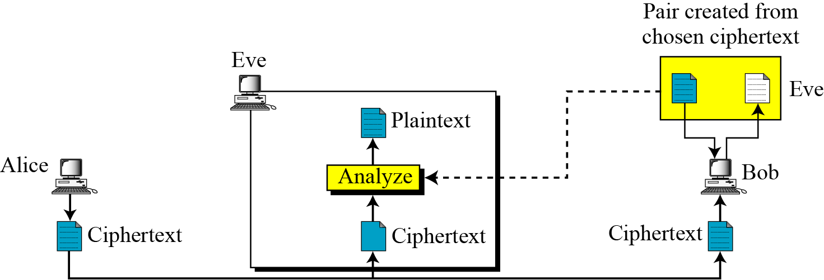
Chosen-Ciphertext Attack
Attacker will attack to chose some ciphertext receiver’s machine.
On that basis try to analyze new intercepted ciphertext.

Slide 9
Brute Force Search
always possible to simply try every key
most basic attack, proportional to key size
assume either know / recognise plaintext
Key Size (bits) | Number of Alternative Keys | Time required at 1 decryption/µs | Time required at 10⁶ decryptions/µs
32 | 2³² = 4.3 × 10⁹ | 2³¹ µs = 35.8 minutes | 2.15 milliseconds
56 | 2⁵⁶ = 7.2 × 10¹⁶ | 2⁵⁵ µs = 1142 years | 10.01 hours
128 | 2¹²⁸ = 3.4 × 10³⁸ | 2¹²⁷ µs = 5.4 × 10²⁴ years | 5.4 × 10¹⁸ years
168 | 2¹⁶⁸ = 3.7 × 10⁵⁰ | 2¹⁶⁷ µs = 5.9 × 10³⁶ years | 5.9 × 10³⁰ years
26 characters (permutation) | 26! = 4 × 10²⁶ | 2 × 10²⁶ µs = 6.4 × 10¹² years | 6.4 × 10⁶ years
Notes:
A brute-force attack involves trying every possible key until an intelligible translation of the ciphertext into plaintext is obtained. On average, half of all possible keys must be tried to achieve success. Stallings Table 2.2 shows how much time is required to conduct a brute-force attack, for various common key sizes (DES is 56, AES is 128, Triple-DES is 168, plus general mono-alphabetic cipher), where either a single system or a million parallel systems, are used.

Slide 10
Network security encryption/ decryption
Three dimensions of cryptographic systems
types of ope.used to trans.
Plain text to cipher text (1)
crypto. Sys. Based on
no. of keys used(2)
way in which plain text is processed(3)
Transposition
type
symmetric
asymmetric
Substitution type
Block cipher
Stream cipher
Monoalphabetic
polyalphabetic
rail fence
pure transposition
cipher
Multip
licative
Affine
Mono
Alpha
betic
Play fair
Hill
cipher
autokey
vigenere
Caesar/ additive

Slide 11
Categories of Traditional ciphers
Substitution cipher
Transposition cipher
A substitution cipher replaces one symbol with another.
Substitution ciphers can be categorized as either monoalphabetic ciphers or polyalphabetic ciphers.
A transposition cipher does not substitute one symbol for another, instead it changes the location of the symbols.

Slide 12
Substitution cipher
Monoalphabetic cipher
Additive Cipher/Ceaser cipher
Multiplicative cipher
Affine cipher

Slide 13
Monoalphabetic cippher
rather than just shifting the alphabet
could shuffle (jumble) the letters arbitrarily
each plaintext letter maps to a different random ciphertext letter
hence key is 26 letters long
Plain: abcdefghijklmnopqrstuvwxyz
Cipher: DKVQFIBJWPESCXHTMYAUOLRGZN
Plaintext: ifwewishtoreplaceletters
Ciphertext: WIRFRWAJUHYFTSDVFSFUUFYA

Slide 14
Monoalphabetic Cipher Security
now have a total of 26! = 4 × 10²⁶
with so many keys, might think is secure
but would be !!!WRONG!!!
problem is language characteristics

Slide 15
Additive Cipher
Simplest monoalphabetic cipher is the additive cipher.
This cipher is sometimes called a shift cipher and sometimes a Caesar cipher.

Slide 16
Additive cipher(Caesar Cipher)
replaces each letter by 3rd letter on
The alphabet is wrapped around so that after Z follows A:
mathematically give each letter a number

Slide 17
Additive cipher(Caesar Cipher)
then have Caesar cipher as:
c = E(k, p) = (p + k) mod (26)
p = D(k, c) = (c – k) mod (26)
example:
c = E (3, p) = (p + 3) mod (26)
p = D(3, c) = (c – 3) mod (26)
Plain text : hello
Cipher text: KHOOR
Plain text : meet me after the toga party
Cipher text: PHHW PH DIWHU WKH WRJD SDUWB

Slide 18
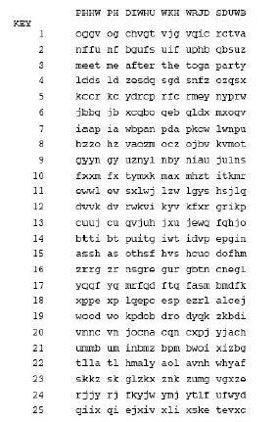
Cryptanalysis of Caesar Cipher
only have 26 possible ciphers
A maps to A,B,..Z
could simply try each in turn
a brute force search.

Slide 19
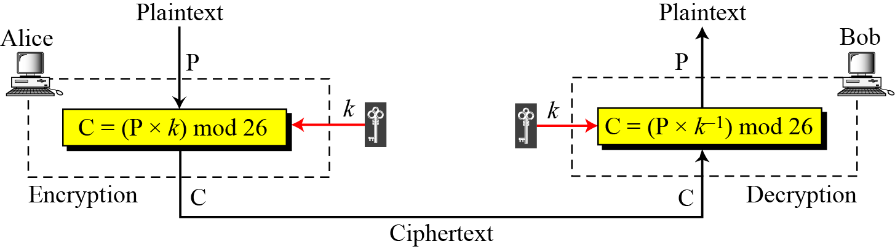
Multiplicative Ciphers
In a multiplicative cipher, the plaintext and ciphertext are integers in Z₂₆.
the key is an integer in Z₂₆*.

Slide 20
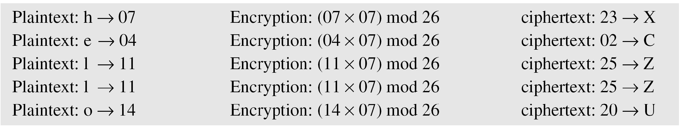
Multiplicative Ciphers
What is the key domain for any multiplicative cipher?
The key needs to be in Z₂₆*.
This set has only 12 members: 1, 3, 5, 7, 9, 11, 15, 17, 19, 21, 23, 25.
Multiplicative cipher to encrypt the message “hello” with a key of 7.
The ciphertext is “XCZZU”.

Slide 21
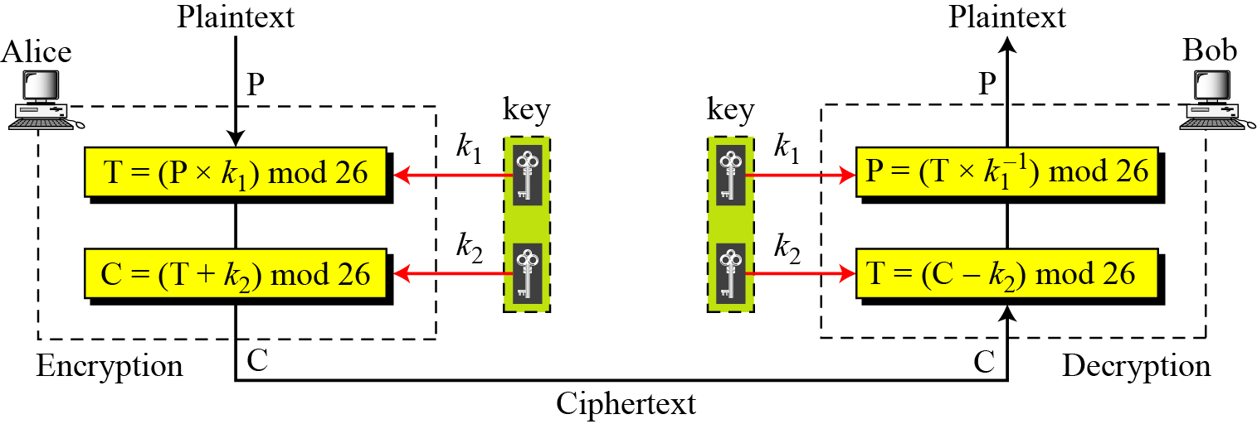
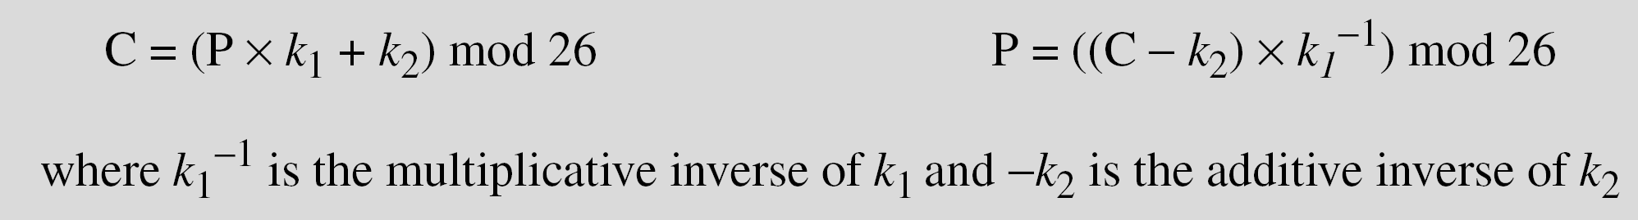
Affine cipher

Slide 22
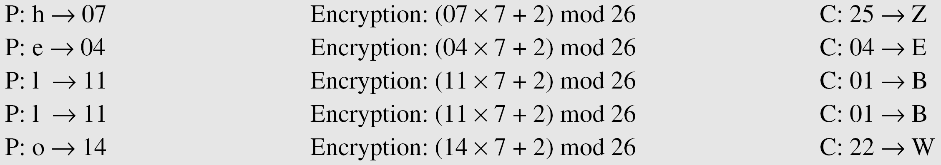
Affine cipher
The affine cipher uses a pair of keys in which the first key is from Z₂₆* and the second is from Z₂₆.
The size of the key domain is 26 × 12 = 312.
Use an affine cipher to encrypt the message “hello” with the key pair (7, 2).

Slide 23
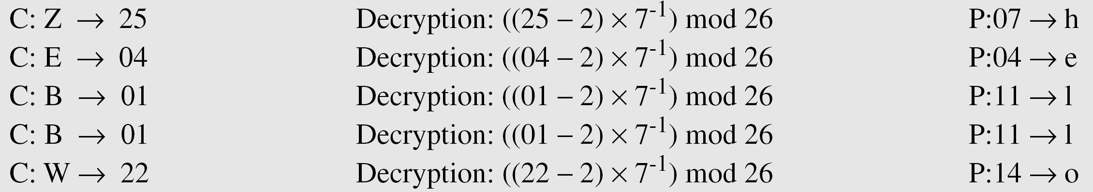
Affine cipher
Use the affine cipher to decrypt the message “ZEBBW” with the key pair (7, 2) in modulus 26.
Solution

Slide 24
Playfair Cipher
not even the large number of keys in a monoalphabetic cipher provides security
one approach to improving security was to encrypt multiple letters
the Playfair Cipher is an example
invented by Charles Wheatstone in 1854, but named after his friend Baron Playfair

Slide 25
Playfair Key Matrix
a 5X5 matrix of letters based on a keyword
fill in letters of keyword (minus duplicates)
fill rest of matrix with other letters
eg. using the keyword MONARCHY
M | O | N | A | R
C | H | Y | B | D
E | F | G | I/J | K
L | P | Q | S | T
U | V | W | X | Z

Slide 26
Encrypting and Decrypting
plaintext is encrypted two letters at a time
If a pair is a repeated letter, insert filler like 'X’
If both letters fall in the same row, replace each with letter to right (wrapping back to start from end)
If both letters fall in the same column, replace each with the letter below it (again wrapping to top from bottom)
Otherwise each letter is replaced by the letter in the same row and in the column of the other letter of the pair
Wireless wi re le sx sz XG MK UL XA TX

Slide 27
Example
M | O | N | A | R
C | H | Y | B | D
E | F | G | I/J | K
L | P | Q | S | T
U | V | W | X | Z
Wireless wi re le sx sz XG MK UL XA TX
Monday mo nd ay ON RY NB

Slide 28
Security of Playfair Cipher
security much improved over monoalphabetic
since have 26 x 26 = 676 digrams
would need a 676 entry frequency table to analyse (verses 26 for a monoalphabetic)
and correspondingly more ciphertext
was widely used for many years
eg. by US & British military in WW1
it can be broken, given a few hundred letters
since still has much of plaintext structure

Slide 29
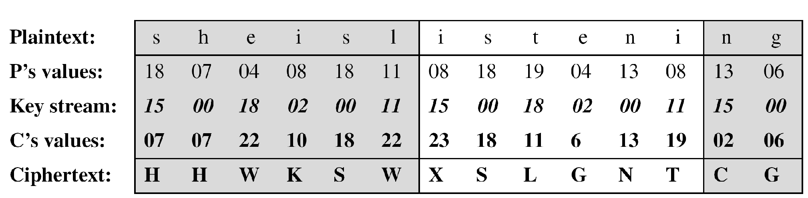
Vigenere Cipher
Example 3.16
We can encrypt the message “She is listening” using the 6-character keyword “PASCAL”.
3.‹#›

Slide 30
Let us see how we can encrypt the message “She is listening” using the 6-character keyword “PASCAL”. The initial key stream is (15, 0, 18, 2, 0, 11). The key stream is the repetition of this initial key stream (as many times as needed).
3.‹#›

Slide 31
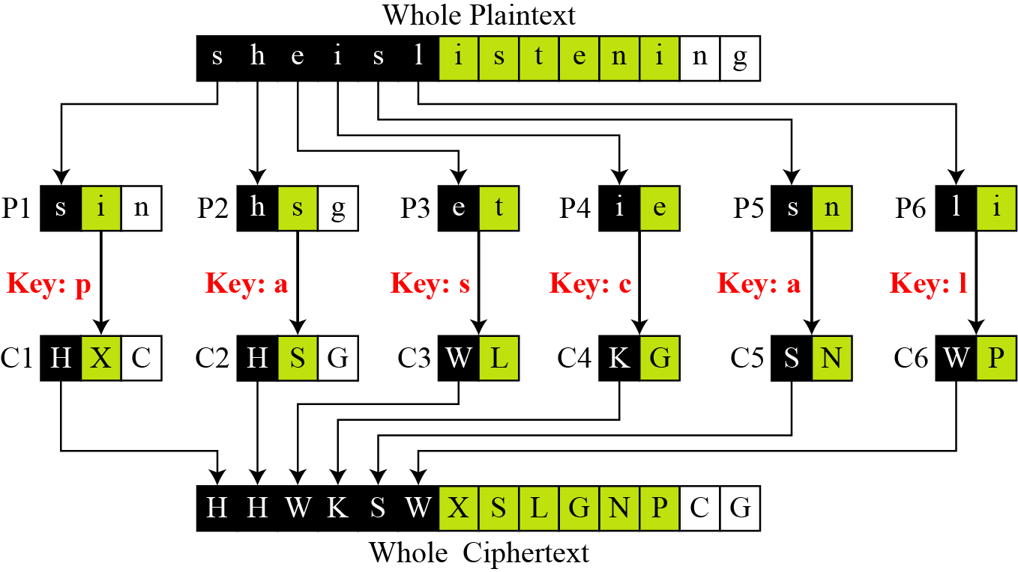
Vigenere cipher can be seen as combinations of m additive ciphers.
Figure 3.14 A Vigenere cipher as a combination of m additive ciphers
3.‹#›

Slide 32
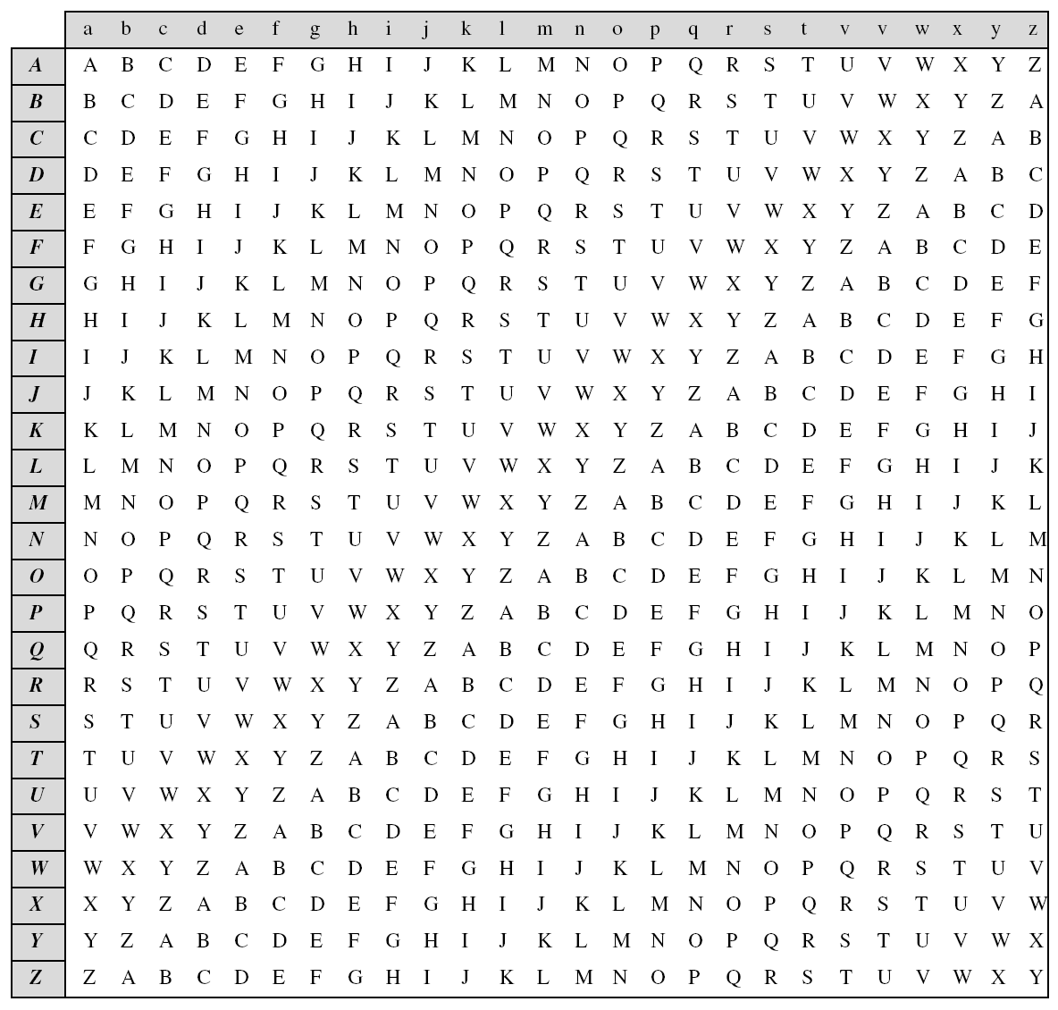
Using we can say that the additive cipher is a special case of Vigenere cipher in which m = 1.
3.‹#›
A Vigenere Tableau

Slide 33
Hill Cipher
Takes two or three or more letter combinations to the same size combinations, e.g. “the” 🡪 “rqv”
Uses simple linear equations
An example of a “block” cipher encrypting a block of text at a time
Numbered alphabet: a = 0, b = 1, c = 2, etc.
Hill cipher
C=E(K, P)=KP mod 26
P=D(K, P)=K⁻¹C mod 26

Slide 34
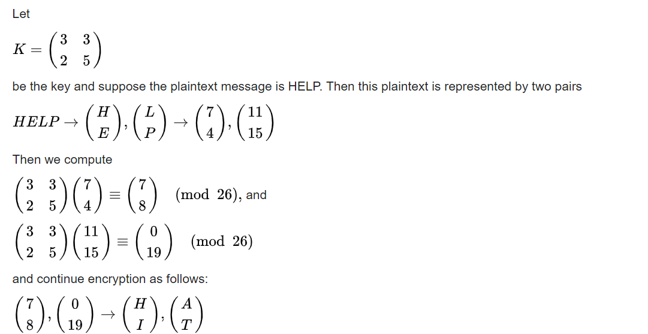
Hill chipher Example 1 encryption

Slide 35
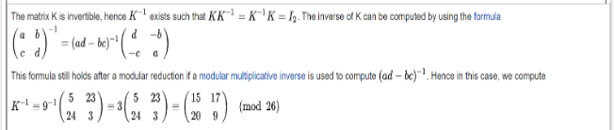
key for decryption

Slide 36
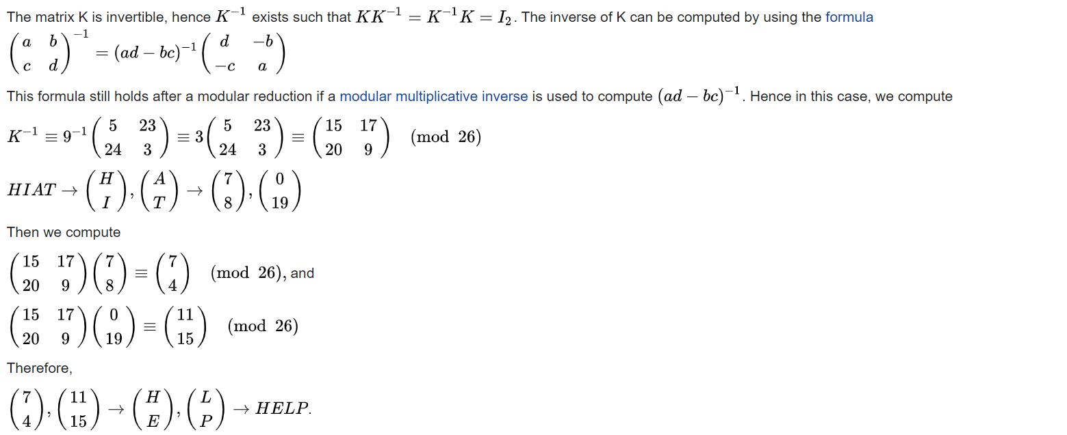
Decryption

Slide 37
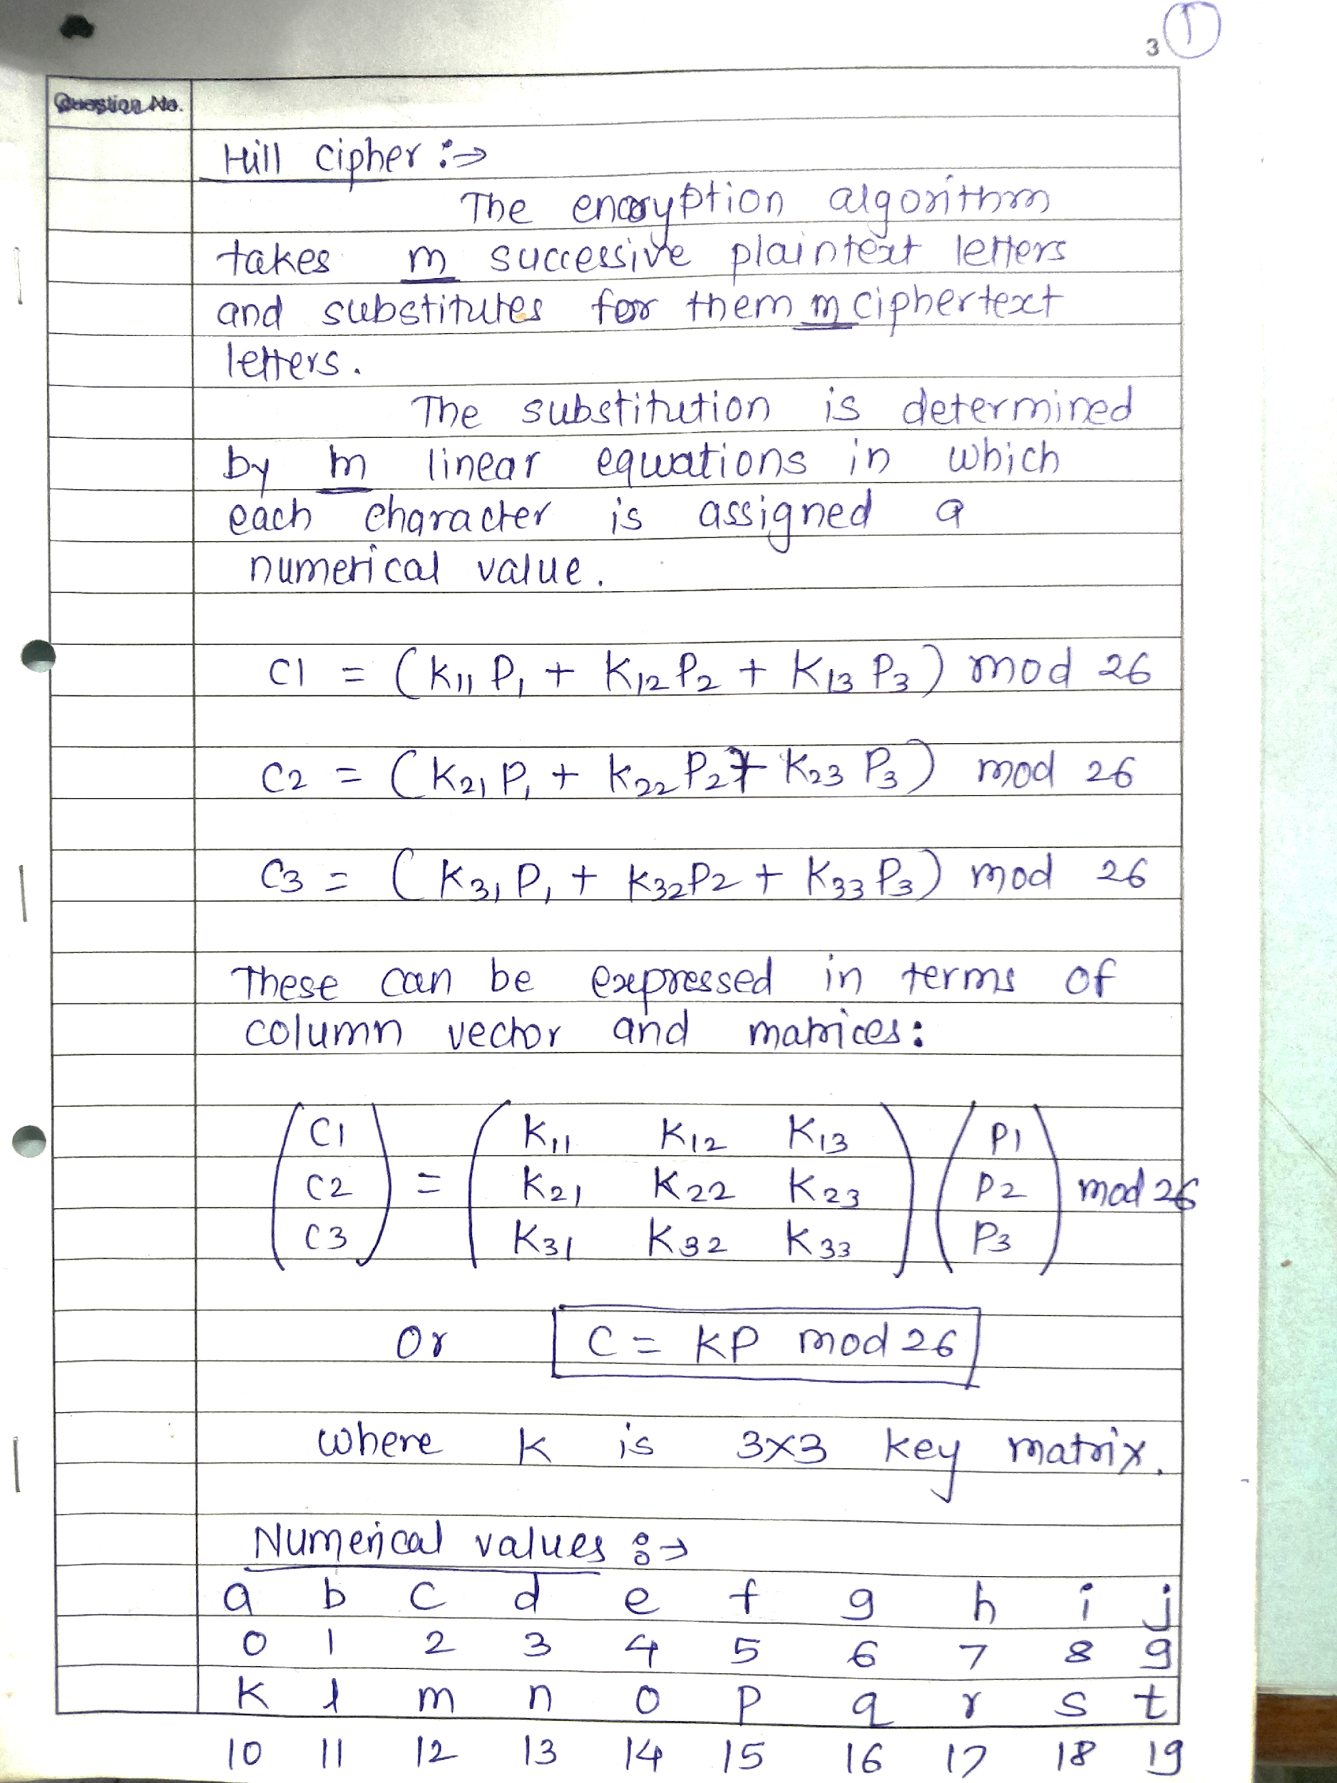
Hill Cipher example2 encryption

Slide 38
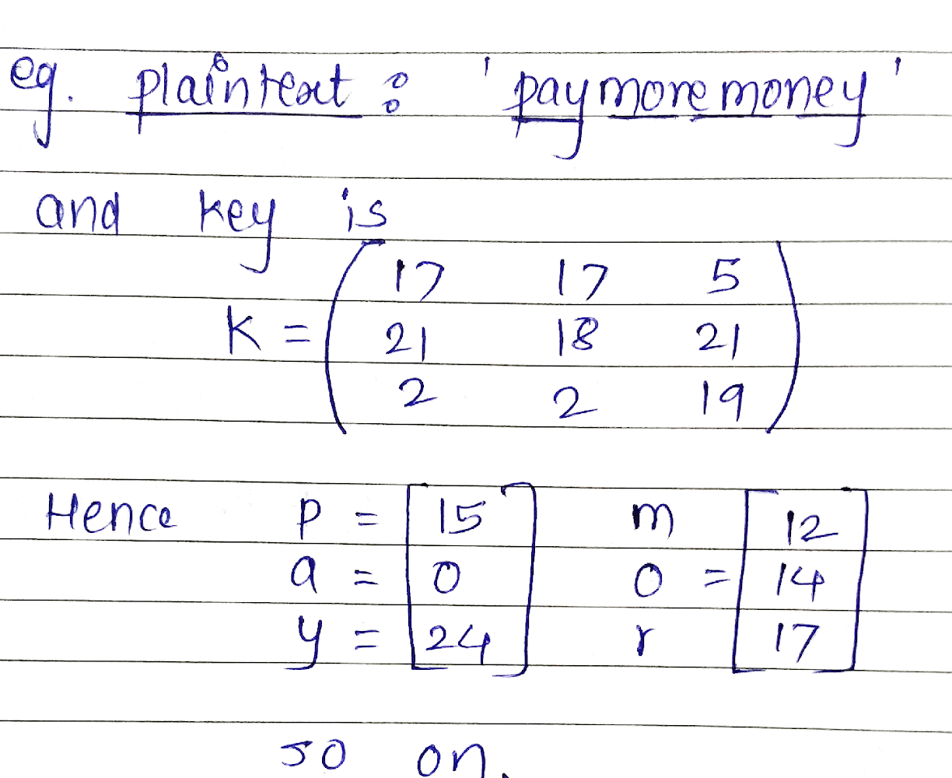
Hill Cipher

Slide 39
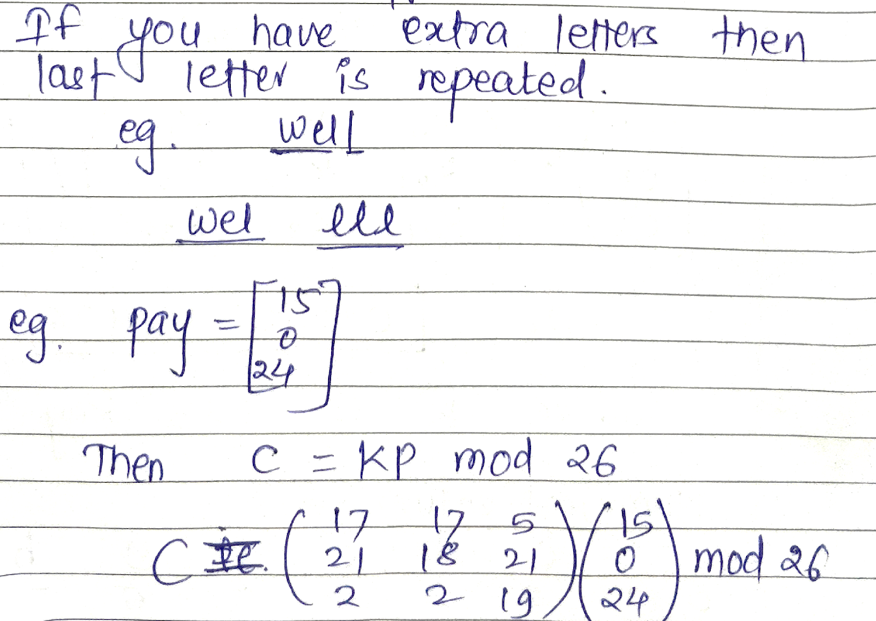
Hill Cipher

Slide 40
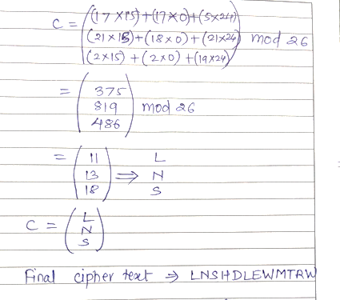
Hill Cipher

Slide 41
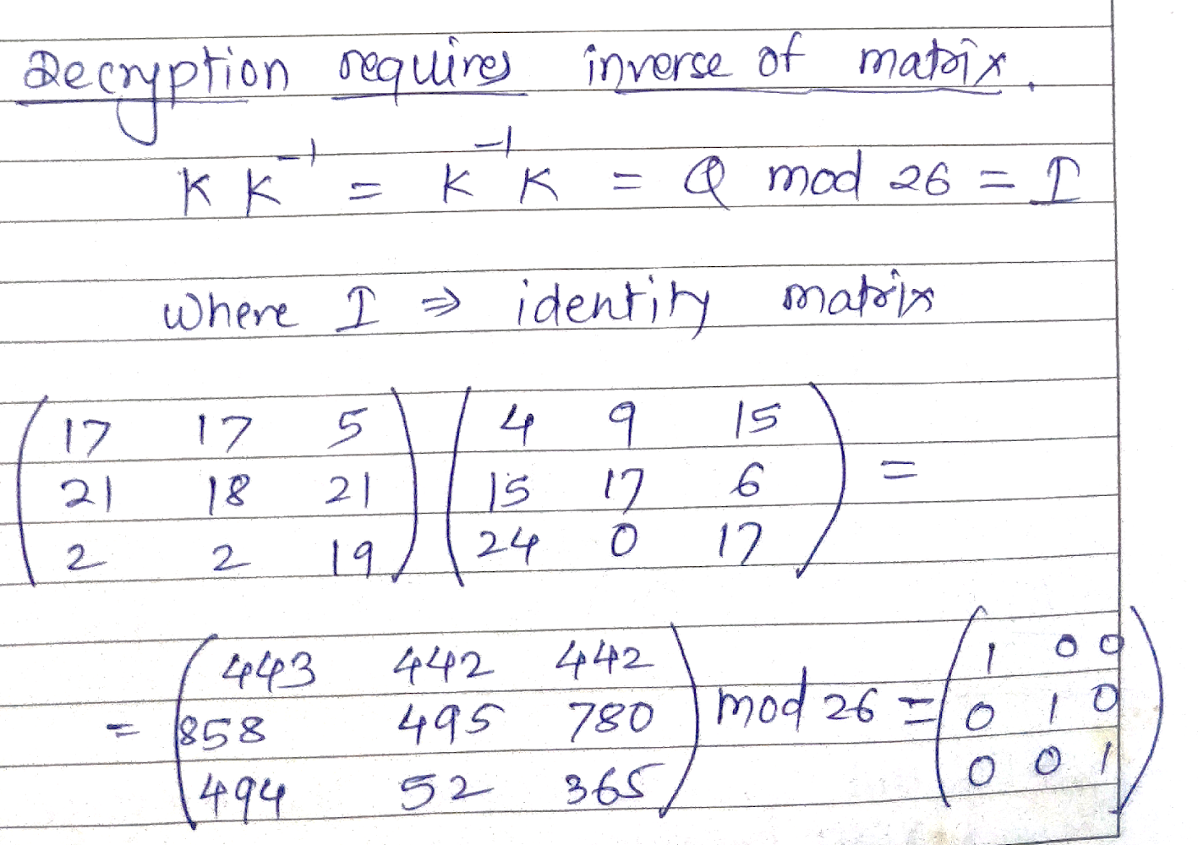
Hill Cipher example 2 decyption

Slide 42
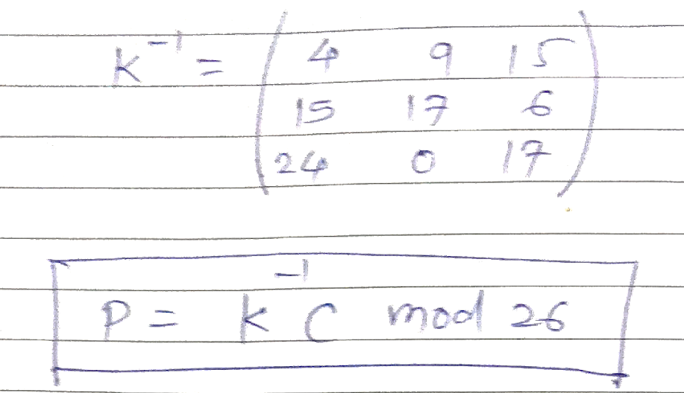
Hill Cipher

Slide 43
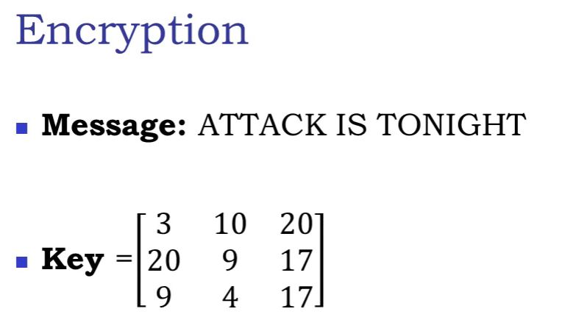
Hill chipper example 3

Slide 44
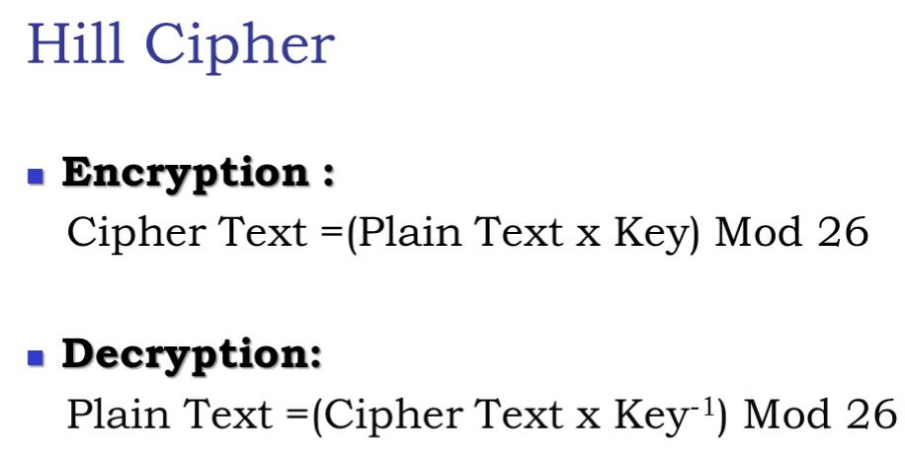

Slide 45
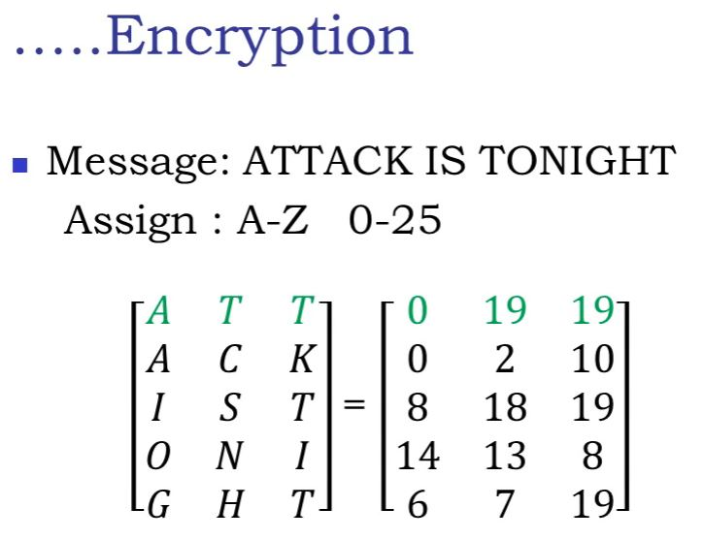

Slide 46
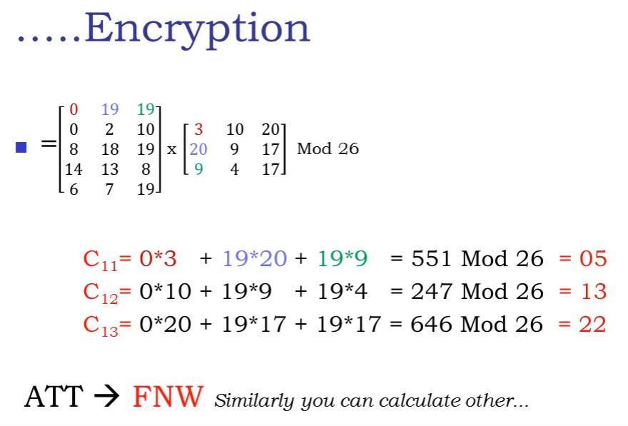

Slide 47
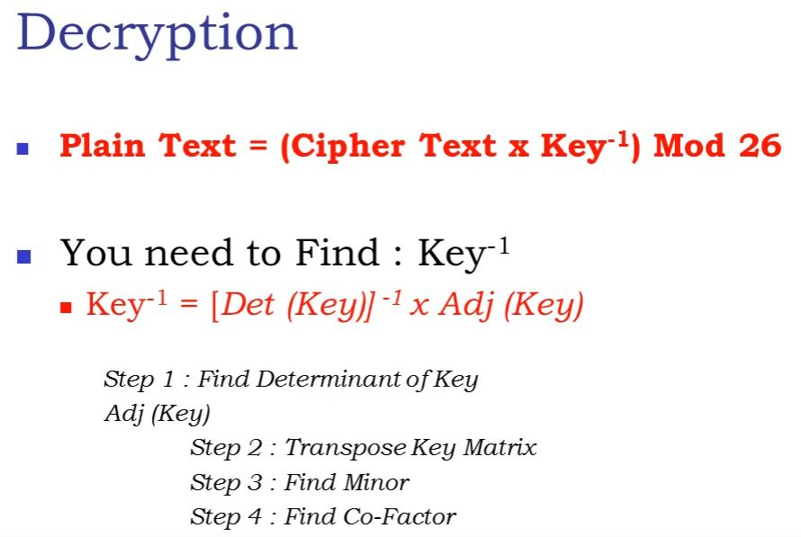

Slide 48
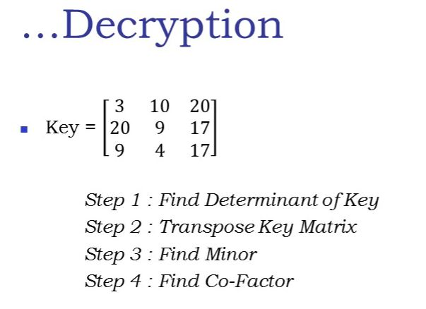

Slide 49
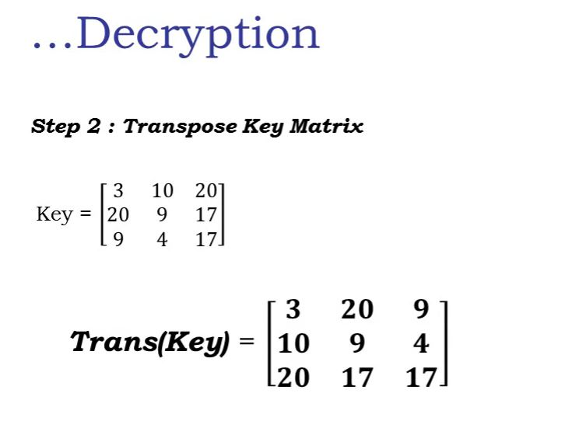

Slide 50
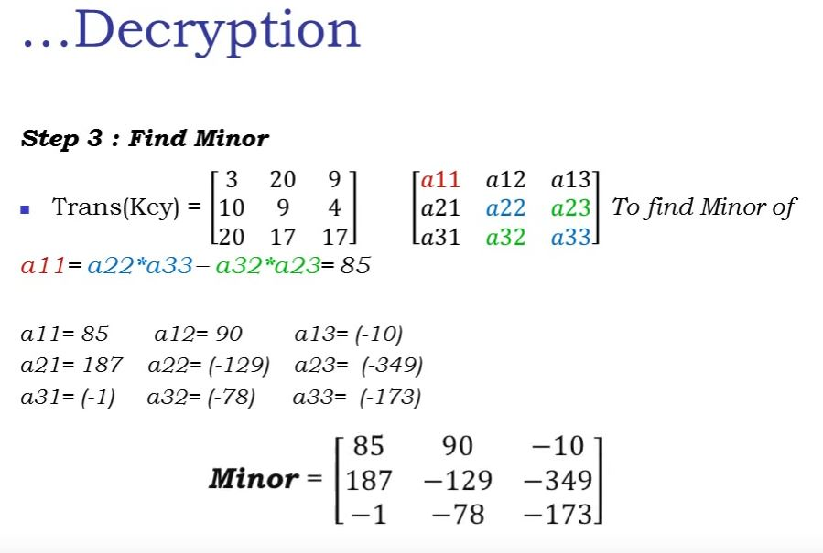

Slide 51
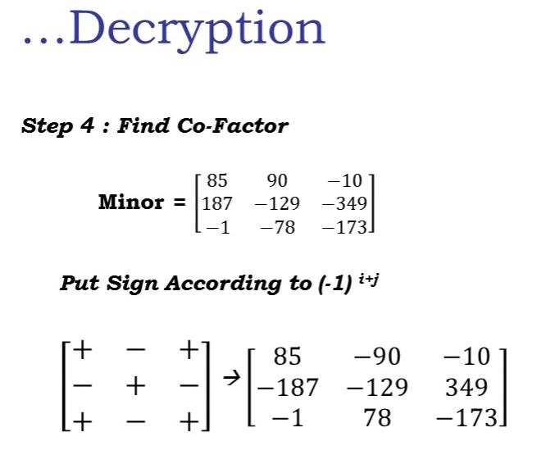

Slide 52
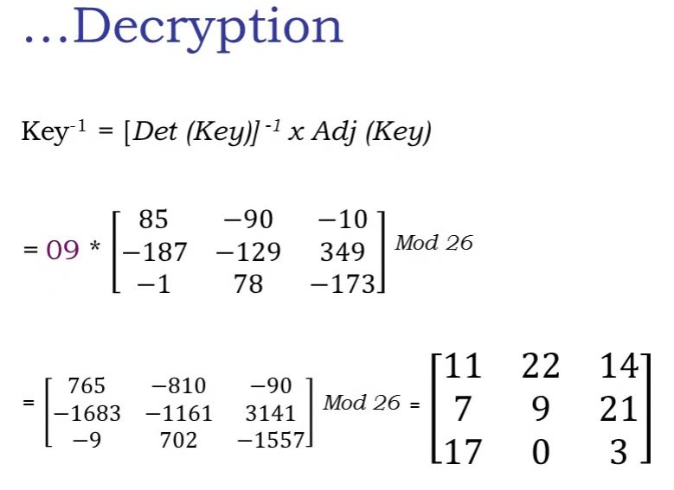

Slide 53
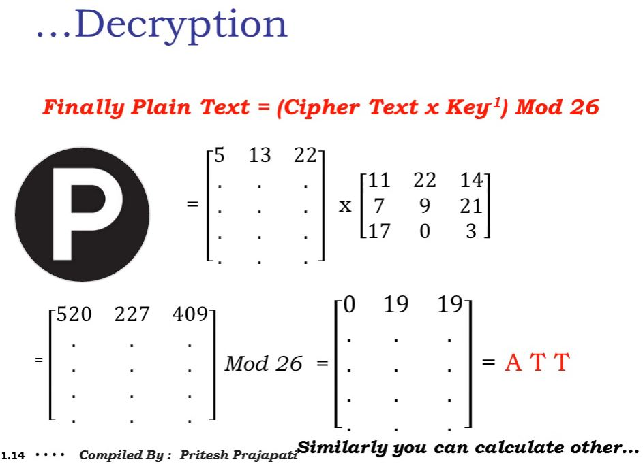

Slide 54
Transposition Ciphers
Transposition or permutation ciphers
These hide the message by rearranging the letter order without altering the actual letters used.
Can recognise these since have the same frequency distribution as the original text

Slide 55
Rail Fence cipher
Write message letters out diagonally over a number of rows
then read off cipher row by row
eg. write message out as: “Meet me at the park”
ciphertext “MEMATEAKETETHPR”.

Slide 56
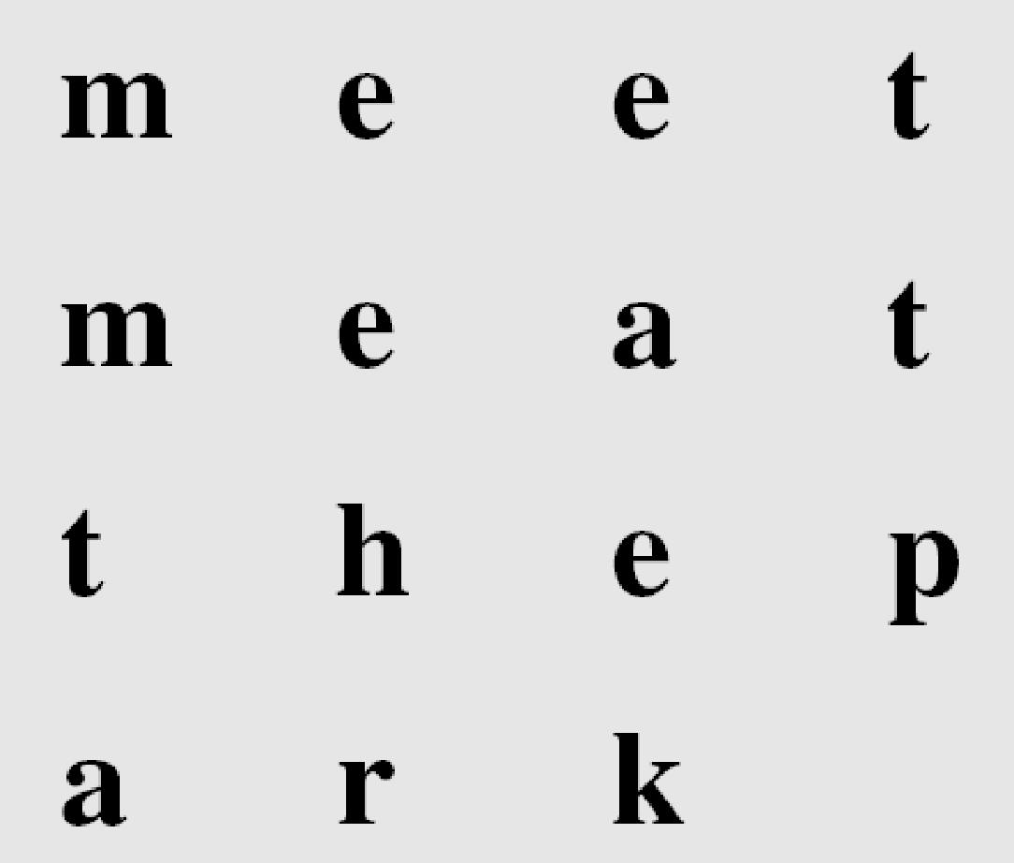
Columnar transposition(without key)
Arrangement of plaintext into columns.
Example: four columns. Plaintext is written row by row, in a table of four columns.
Plain text: meet me at the park
Cipher text: “MMTAEEHREAEKTTP”.

Slide 57
Keyed Transposition Ciphers
The keyless ciphers permute the characters by using writing plaintext in one way and reading it in another way The permutation is done on the whole plaintext to create the whole ciphertext. Another method is to divide the plaintext into groups of predetermined size, called blocks, and then use a key to permute the characters in each block separately.
3.‹#›

Slide 58
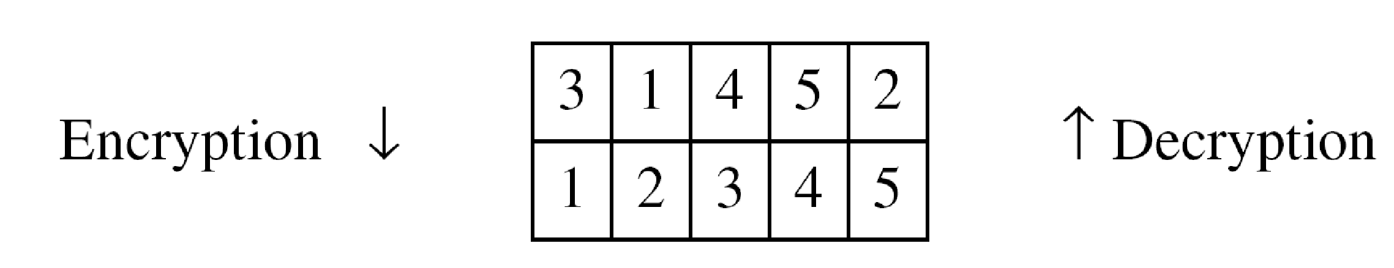
Alice needs to send the message “Enemy attacks tonight” to Bob..
The key used for encryption and decryption is a permutation key, which shows how the character are permuted.
The permutation yields
3.‹#›

Slide 59
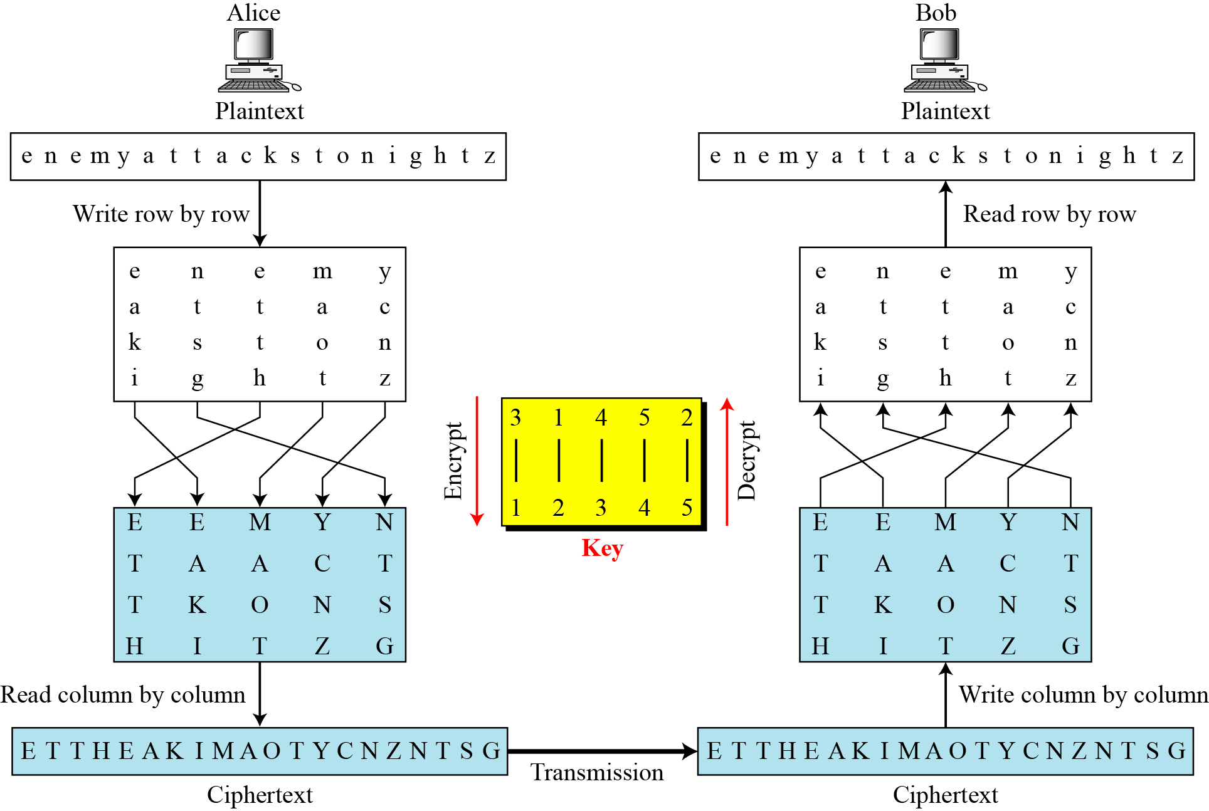
3.3.3 Combining Two Approaches
Example 3.26
Figure 3.21
3.‹#›

Slide 60
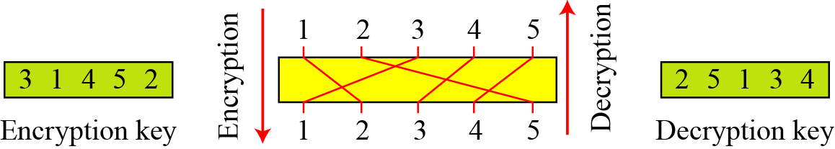
Keys
In Example a single key was used in two directions for the column exchange: downward for encryption, upward for decryption. It is customary to create two keys.
Figure 3.22 Encryption/decryption keys in transpositional ciphers
3.‹#›

Slide 61
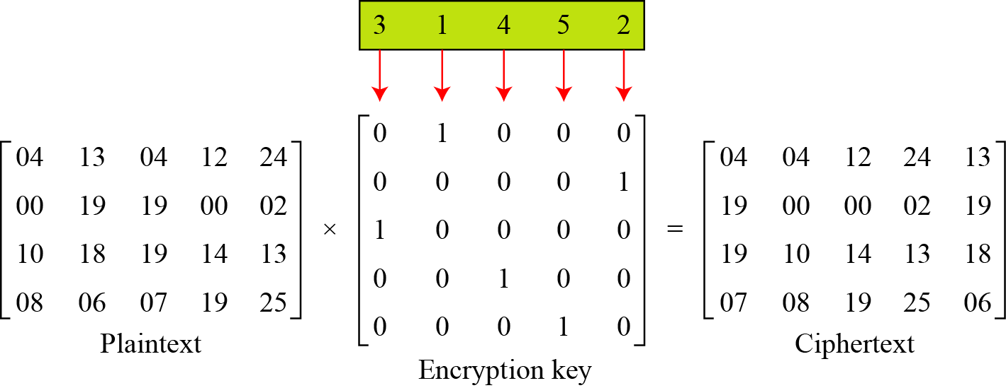
Using Matrices
We can use matrices to show the encryption/decryption process for a transposition cipher.
Example 3.27
Figure 3.24 Representation of the key as a matrix in the transposition cipher
3.‹#›

Slide 62
Columnar transposition(with key)
write letters of message out in rows over a specified number of columns
then reorder the columns according to some key before reading off the rows
plain text: this is css third year class
Key: 3 4 2 1 5
t h i s i
s c s s t
h i r d y
e a r c l
a s s z z
Ciphertext: ISRRSSSDCZHCIASTSHEAITYLZ

Slide 63
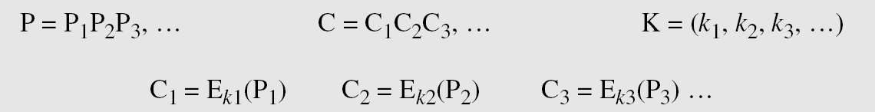
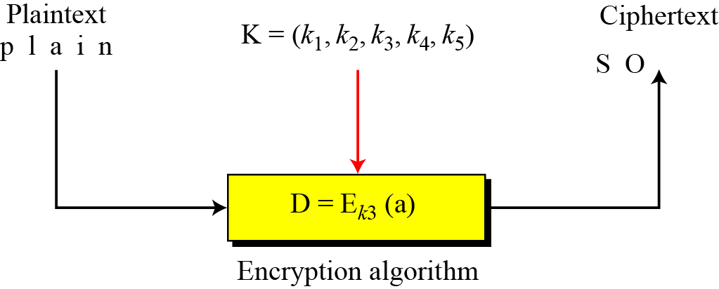
Stream Ciphers
Call the plaintext stream P, the ciphertext stream C, and the key stream K.
Additive ciphers, monoalphabetic ciphers are examples of stream ciphers as they process stream of characters.

Slide 64
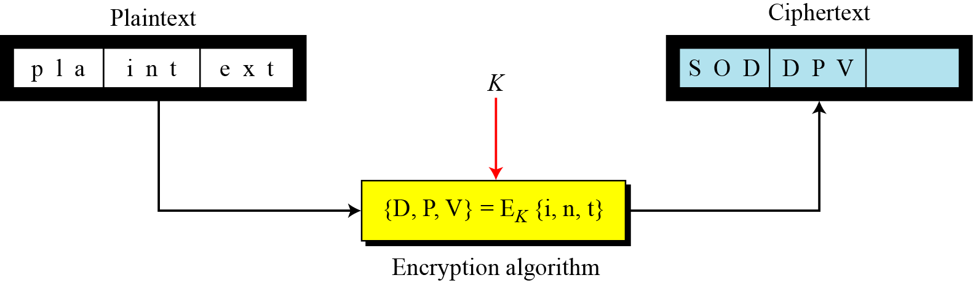
Block Ciphers
In a block cipher, a group of plaintext symbols of size m (m > 1) are encrypted together creating a group of ciphertext of the same size.
A single key is used to encrypt the whole block

Slide 65
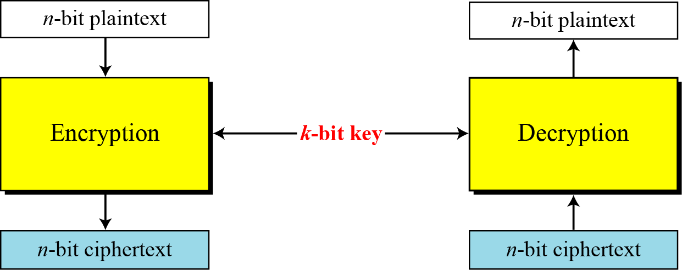
Block cipher
A symmetric-key modern block cipher encrypts an n-bit block of plaintext or decrypts an n-bit block of ciphertext. The encryption or decryption algorithm uses a k-bit key.

Slide 66
Confusion and Diffusion
Diffusion : to hide the relationship between the cipher text and the plain text.
Diffusion implies that each symbol in the cipher text is dependent on some or all symbols in the plain text.
This will frustrate the opponent who use cipher text statistics to find the plain text.
Confusion: to hide the relationship between the cipher text and the key.
If a single bit in the key is changed most or all bits in the cipher text will also be changed.
This will frustrate the opponent who use cipher text statistics to find the key

